Slide 1
Public Key Cryptography
Authentication
Part Two

Slide 2
Message Authentication
message authentication is concerned with:
  protecting the integrity of a message
  validating identity of originator
  non-repudiation of origin (dispute resolution)
the three alternative functions used:
  hash function
  message encryption
  message authentication code (MAC)

Slide 3
Hash Functions
condenses arbitrary message to fixed size
  h = H(M)
usually assume hash function is public
hash used to detect changes to message
want a cryptographic hash function
  computationally infeasible to find data mapping to specific hash (one-way property)
  computationally infeasible to find two data to same hash (collision-free property)

Slide 4
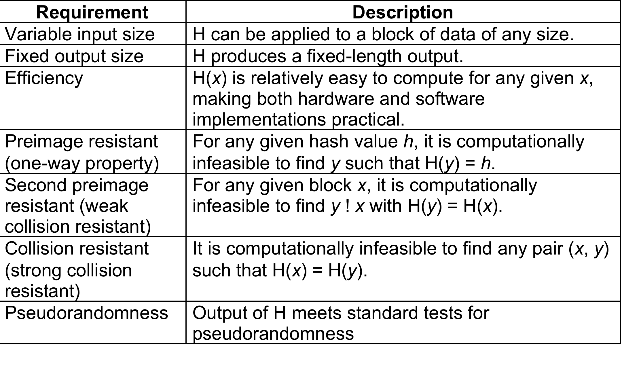
Hash Function Requirements

Slide 5
Secure Hash Algorithm
SHA originally designed by NIST & NSA in 1993
was revised in 1995 as SHA-1
produces 160-bit hash values
However, the results on security of SHA-1 have raised concerns on its use in future applications

Slide 6
Revised Secure Hash Standard
NIST issued revision FIPS 180-2 in 2002
adds 3 additional versions of SHA
  SHA-256, SHA-384, SHA-512
designed for compatibility with increased security provided by the AES cipher
structure & detail is similar to SHA-1
but security levels are rather higher

Slide 7

SHA Versions

